Slide 1

Computer Organization And Architecture
CPEN6260010 (2 Credits)
Session 1: Introduction to Computer Organization and Architecture
Dr. Endra, S.Kom., M.T.
D2395

Slide 2
Learning Outcomes
LO-1: Explain the underlying mathematical and logical principles of various data representations (e.g., integer, floating-point, character codes) used in computer systems.
LO-2: Explain the fundamental structure and operation of the Central Processing Unit (CPU), including the roles and interactions of its main components (e.g., ALU, control unit, registers) during instruction execution.

Slide 3
OUTLINE
Overview: Organization vs. Architecture
Computer Systems: Core Components & Equivalence
Example System: Wading Through the Jargon
Standards Organizations
Historical Development & Moore's Law
The Computer Level Hierarchy
Cloud Computing
The Fragility of the Internet & the IoT
The Von Neumann Model
Non-Von Neumann & Parallel Computing

Slide 4
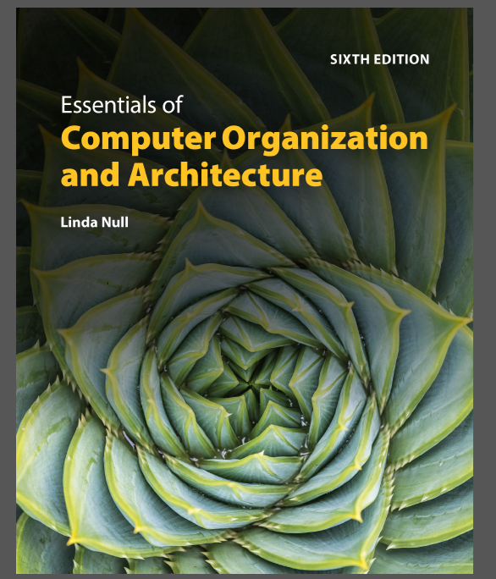
TEXTBOOK
Linda Null. (2023). Essentials of Computer Organization and Architecture with Navigate Advantage Access. Jones & Bartlett Learning. 25 Mall Road Burlington, MA 01803. ISBN: 1284259439.

Slide 5
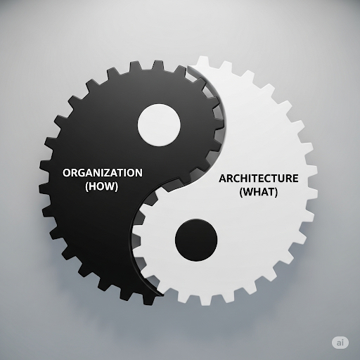
Overview: Organization vs. Architecture
Organization Vs. Architecture: The Key Distinction
The study of computer organization addresses issues such as control signals, signaling methods, and memory types. It encompasses all physical aspects of computer systems and helps us answer the question: How does a computer work?
The study of computer architecture focuses on the logical and abstract aspects, including instruction sets, operation codes, data types, registers, and addressing modes. It helps us answer: How do I design a computer?

Slide 6
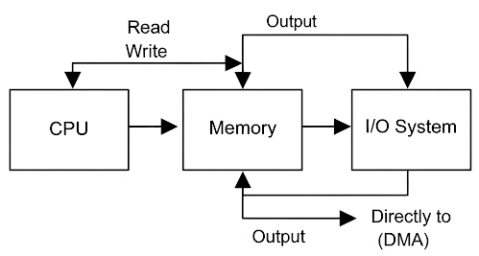
Computer Systems: Core Components & Equivalence
The Three Core Components of a Computer
At the most basic level, a computer is a device consisting of three pieces:
A processor (CPU) to interpret and execute programs.
A memory to store both data and programs.
A mechanism for transferring data to and from the outside world (I/O system).

Slide 7
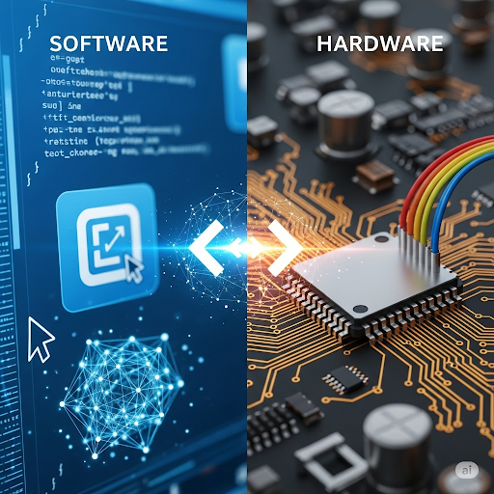
Computer Systems: Core Components & Equivalence
Hardware-Software Equivalence
The principle of equivalence of hardware and software states that any task done by software can also be done using hardware, and any operation performed directly by hardware can be done using software. This gives designers a choice, though hardware implementations are almost always faster. This trade-off between speed and flexibility is crucial for design decisions.

Slide 8
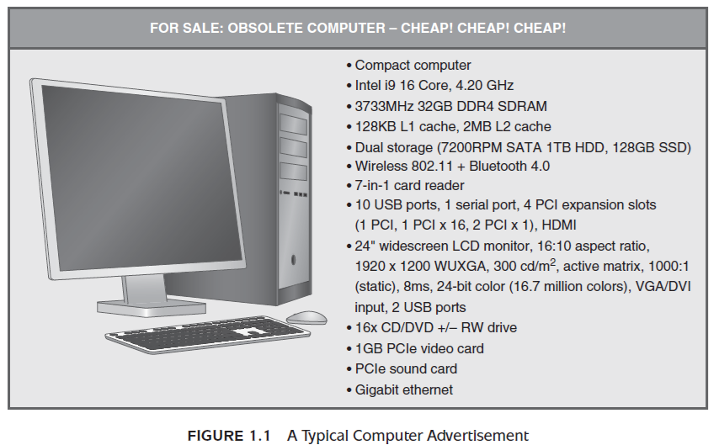
Example System: Wading Through the Jargon
A Look at Computer Jargon
Computer advertisements often contain a confusing array of terminology. Terms like '4.20 GHz,' '32GB DDR4 SDRAM,' and '128KB L1 cache' all refer to specific components or their characteristics. As we progress through this course, you will learn the meaning of this jargon, which refers to crucial components like the CPU, memory, and cache.

Slide 9
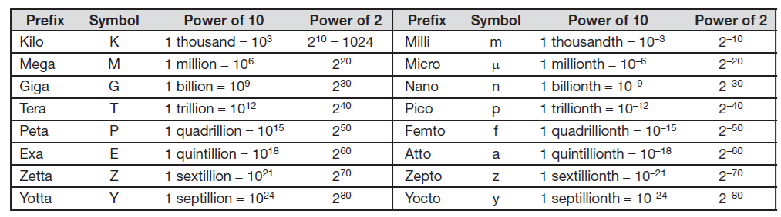
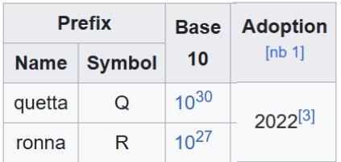
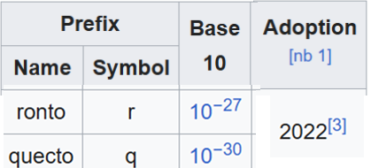
Example System: Wading Through the Jargon
A Look at Computer Jargon
https://en.wikipedia.org/wiki/Metric_prefix

Slide 10


Standards Organizations
The Importance of Standards
Standards organizations are crucial because they ensure that computer equipment from different manufacturers can work together. Some are ad hoc trade associations, while others, like the Institute of Electrical and Electronics Engineers (IEEE) and the International Organization for Standardization (ISO), have formal charters and are recognized internationally. The IEEE sets standards for various components, signaling protocols, and data representation.
https://brand-experience.ieee.org/guidelines/master-brand-and-logos/
https://www.iso.org/iso-name-and-logo.html

Slide 11
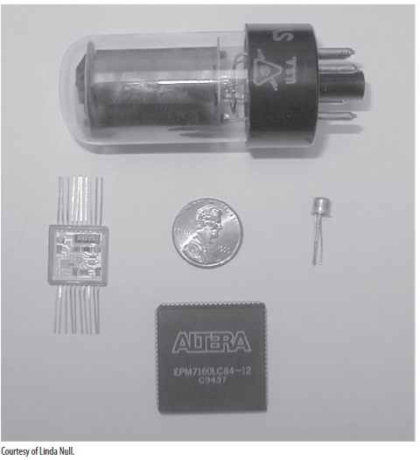
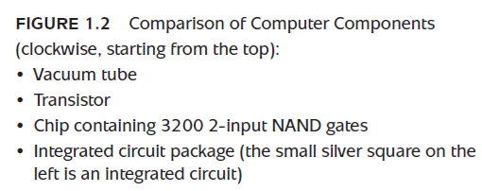
Historical Development & Moore's Law
Computer Generations & Moore's Law
Computers have evolved rapidly through generations defined by their core technology:
1st Gen (1945-1953): Vacuum Tube Computers (e.g., ENIAC).
2nd Gen (1954-1965): Transistorized Computers.
3rd Gen (1965-1980): Integrated Circuit (IC) Computers.
4th Gen (1980-????): VLSI (Very-Large- Scale Integration) Computers.

Slide 12
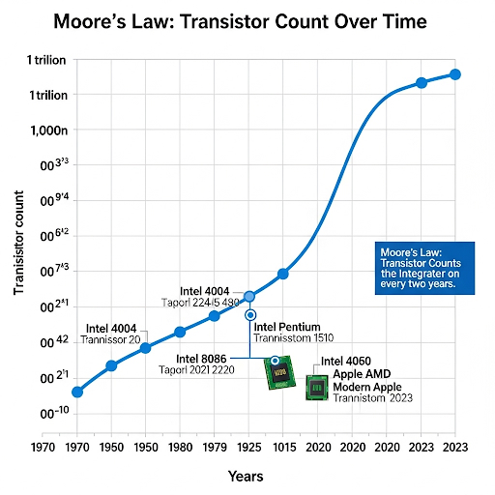
Historical Development & Moore's Law
Computer Generations & Moore's Law
This rapid evolution was driven by Moore's Law, which observed that the number of transistors on an integrated circuit doubles approximately every 18-24 months.

Slide 13
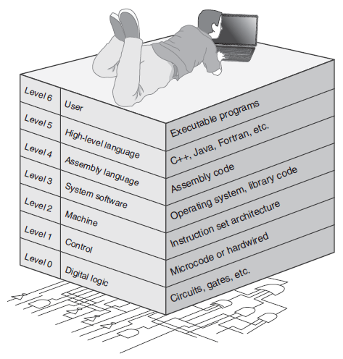
The Computer Level Hierarchy
The Computer Level Hierarchy: Layers of Abstraction
To manage the immense complexity of modern computers, we view them as a hierarchy of levels, each representing a 'virtual machine' with a specific function and set of instructions. This principle of abstraction allows us to focus on one level at a time without needing to understand the intricate details of all lower levels simultaneously. This hierarchy bridges the 'semantic gap' between high-level programming languages and the underlying digital logic gates.

Slide 14
Cloud Computing
Cloud Computing: Computing as a Service
Cloud computing is a general term for any type of virtual computing platform provided over the Internet that offers a set of shared resources, such as storage, networking, and applications. Services can be categorized based on the level of the computer hierarchy they provide:
SaaS (Software as a Service): Provides a complete application over the Internet (e.g., Gmail).
PaaS (Platform as a Service): Provides a platform (OS, database) for you to develop your own applications.
IaaS (Infrastructure as a Service): Provides access to basic computer hardware (servers, network).

Slide 15
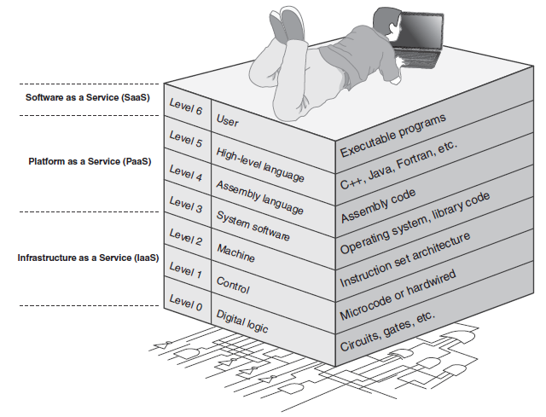
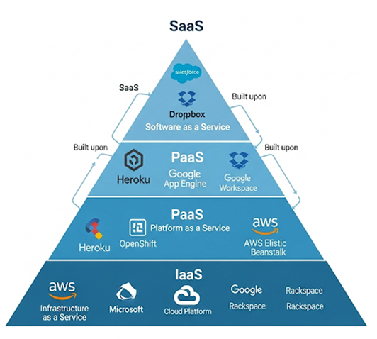
Cloud Computing
Cloud Computing: Computing as a Service

Slide 16
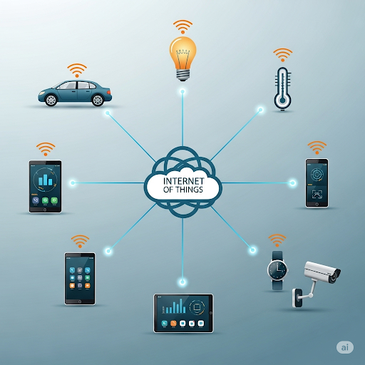
The Fragility of the Internet & the IoT
The Internet and The IoT
Our dependence on the Internet has grown to critical levels, and it forms the fabric for systems that run our infrastructure, known as SCADA networks. A more numerous collection of devices is the Internet of Things (IoT), which includes everything from home appliances to security systems, all of which communicate wirelessly. While the Internet is robust, it is still fragile, and an outage or attack could have serious consequences for our interconnected world.

Slide 17
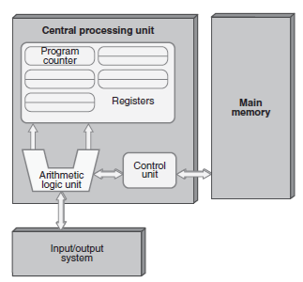
The Von Neumann Model
The Von Neumann Model
Almost all modern general-purpose computers are based on the Von Neumann Architecture. Its key characteristic is the 'stored-program concept': both program instructions and data are stored in the same single memory space. This model consists of three hardware systems: a CPU, a main memory, and an I/O system. It also has a single path between memory and the CPU, which is often referred to as the von Neumann bottleneck.

Slide 18
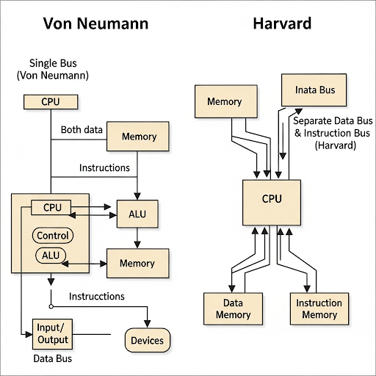
Non-Von Neumann & Parallel Computing
Beyond Von Neumann: Parallel Computing
Non-von Neumann architectures are those in which the model of computation varies from the characteristics listed for the von Neumann architecture, such as having separate buses for data and instructions (Harvard architecture).
Parallel processing is a collection of architectures, from multiple separate computers to multiple cores on the same chip, that do not process instructions sequentially. It is the most popular form of non-von Neumann computing and is used to solve some of our biggest problems.

Slide 19
Evaluation
Session 1 Exercises
What are the two driving factors in the development of computers?
In the von Neumann model, explain the purpose of the processing unit.
What are the limitations of Moore’s Law? Why can’t this law hold forever? Explain.

Slide 20
Reference
Linda Null. (2023). Essentials of Computer Organization and Architecture with Navigate Advantage Access. Chapter 1: Introduction. Jones & Bartlett Learning. 25 Mall Road Burlington, MA 01803. ISBN: 1284259439.

Slide 21


